Slide 1
MULTI-SCALE TEMPLATE MATCHING
Guided By :Dr. Rajlaxmi Chouhan
Ashish Ledalla (B18EE008)
Rohit Kumar Sahu (B18BB029)
Nagamalla Rohith (B18CSE065)
Jevala Sripad (B18CSE019)
Barad Dheeraj Bharadwaj (B18CSE009)

Slide 2
An Overview
Template and image are given as input.
Convert template and image from RGB to grayscale.
Edge Detection is performed on both image and template.
Resize image on different scales.
The template is correlated over the image at each scale.
At the same time correlation coefficient is calculated and the maximum is considered.
Detect the template in the image by putting a rectangle around the patch in the image and show it in the output.

Slide 3
Conversion from RGB to Grayscale
Edge Detection
R,G and B are separately multiplied with respective weights and added together to give a 2D image
img=img[ : , : , 0] * 0.299 + img[ : , : , 1] * 0.587 + img[ : , : , 2] * 0.114
It is done in 5 steps :
Noise Reduction
Gradient Calculation
Non-Maximum Suppression
Double Threshold
Edge tracking by Hysteresis

Slide 4
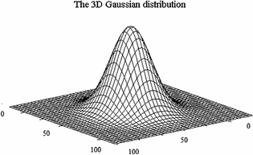
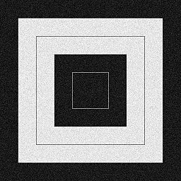
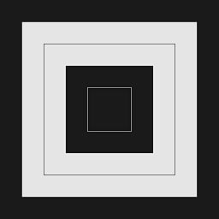
Noise Reduction
Convoluted with Gaussian kernel.
Blurs the image.
Smaller the kernel size less will the blur.
With noise
Without noise

Slide 5
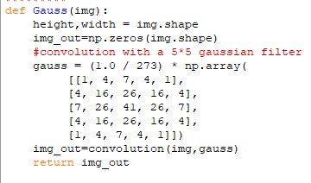

Slide 6
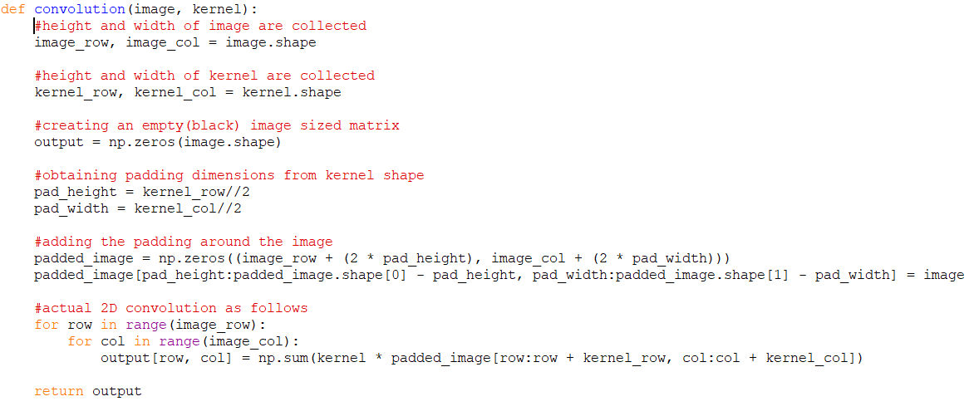

Slide 7
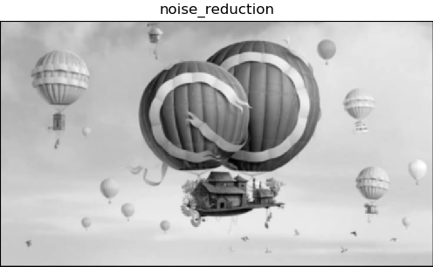

Slide 8


Gradient Calculation
Detects the edge intensity and direction by calculating the gradient of the image.
When the image is smoothened the derivatives Ix and Iy w.r.t x and y are calculated. It can be implemented by convolving I with Sobel Kernels Kx and Ky respectively:
Then the magnitude G and slope θ of the gradient are calculated as follow:

Slide 9
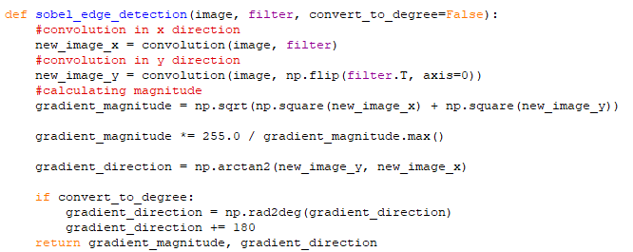

Slide 10
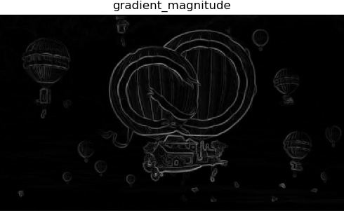

Slide 11
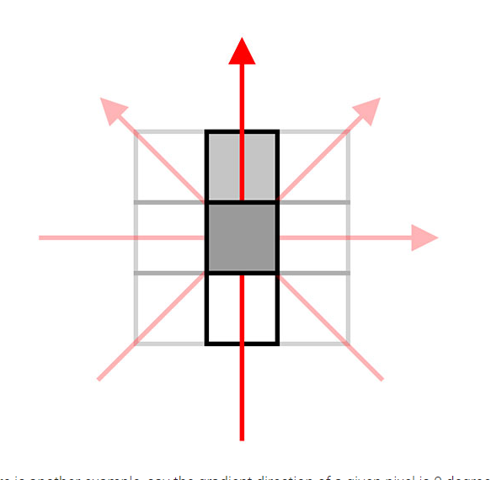
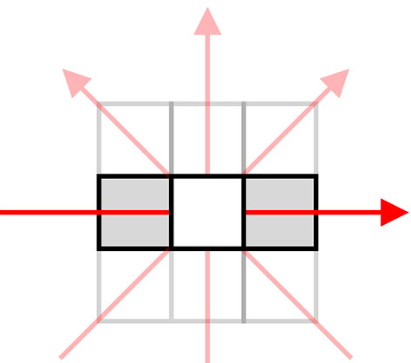
Non-Maximum Suppression
If a pixel is more intense than a surrounding pixel, replace it with the magnitude of the gradient.
If a pixel is less intense than surrounding then set the intensity to 0.
If there is no change in intense of a pixel along it will be replaced with zero.

Slide 12
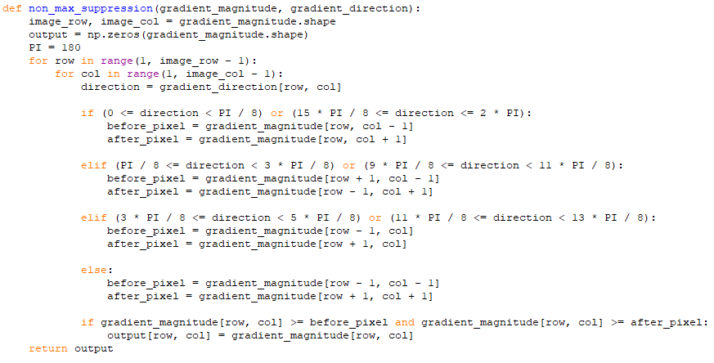

Slide 13
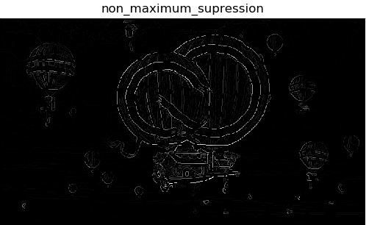

Slide 14
Double Threshold
Double Threshold aims at identifying 3 kinds of pixels strong, weak and non-relevant.
The high threshold used to identify strong pixels.
The low threshold used to identify the non-relevant pixels.
All pixels having intensity between both thresholds are considered as weak and hysteresis mechanism will help us identify the ones that could be considered as strong and the ones that are considered as non-relevant.

Slide 15
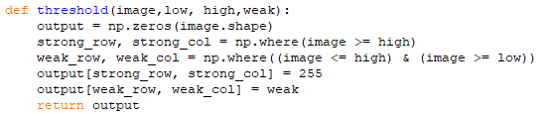

Slide 16
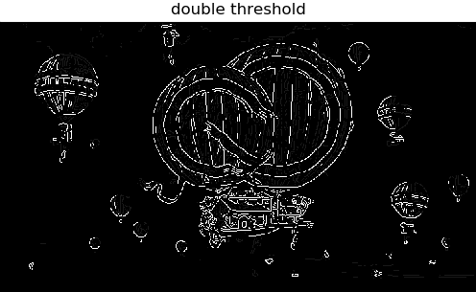

Slide 17
Hysteresis
Based on the threshold results, the hysteresis consists of transforming weak pixels to strong ones, if and only if at least one of the pixels around the one being processed is a strong one.
After this, we are left with a binary image of intensities 0 (black) or 255(white edge) which is the final edge detected image.

Slide 18
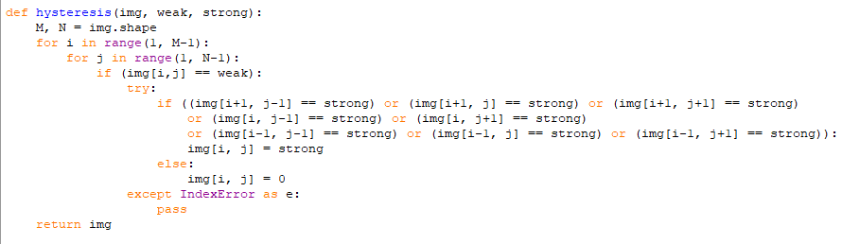

Slide 19


Slide 20
Resizing the image and finding correlation coefficient
Since the size of the patch in the image might not be the same as the size of the template.
Resize the image for a certain set of scales
Calculate correlation coefficient between the template and different patches of the resized image and keep a record of the position where the maximum coefficient is observed.
A rectangle is put at the position where the maximum is observed(among all the resized images).

Slide 21
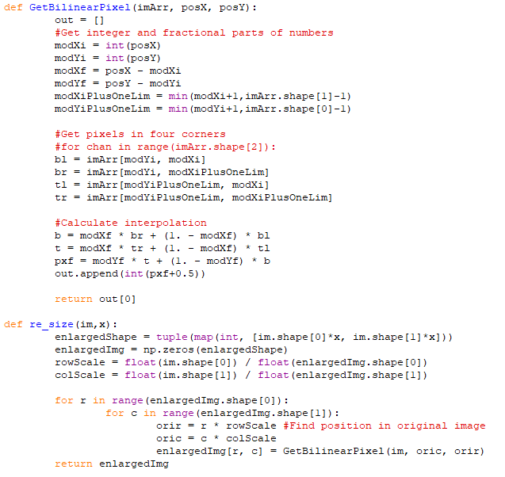

Slide 22
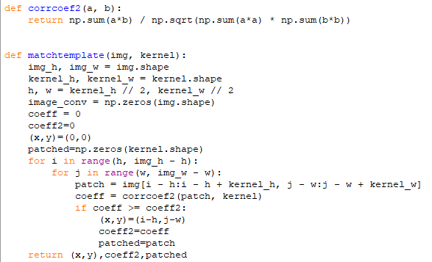

Slide 23


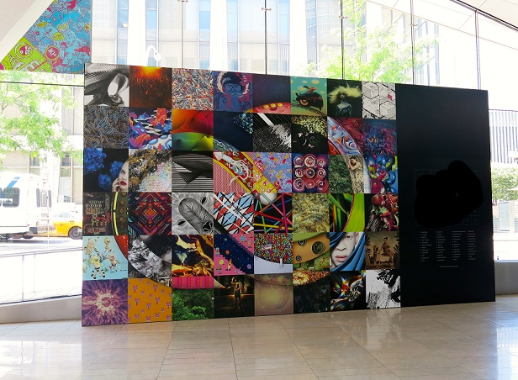

Input Images
Image1
Template
Image 3
Image 2

Slide 24
Thank you

